Slide 1
[320] Welcome + First Lecture
[reproducibility]
Yiyin Shen

Slide 2

Who am I?
Yiyin Shen
CS PhD student
Email: yshen82@wisc.edu
Research Interest
CS Education
Large Language Models
Teaching Experience
CS320 TA => Head TA => Instructor
CS220, CS402 Guest Lectures

Slide 3
Who are You?
Year in school?
Major?
Please fill out the Student Information form:
(due Wed, June 7th):
https://forms.gle/bSGCkxBW7MPGGeHQ6
Why?
Help me get to know you
Get survey credit
Group formation

Slide 4


Related courses
Upper Level Computer Science
Upper Level Data Science
CS 400
CS 354
CS 300
CS 320
STAT 340
L I S 461
CS 252
CS 200
CS 220
STAT 240
systems
(C)
programming
(Java)
data programming
(Python)
data modeling
(R)
ethics
P1 (Project 1) will help 300-to-320 students pickup Python.

Slide 5
Welcome to Data Science Programming II!
Builds on CS220. https://stat.wisc.edu/undergraduate-data-science-studies/
CS220
CS320
getting results
getting reproducible results
writing correct code
writing efficient code
using objects
designing new types of objects
functions: f(obj)
methods: obj.f()
lists + dicts
graphs + trees
analyzing datasets
collecting + analyzing datasets
plots
visualizations
tabular analysis
simple machine learning
CS220 content (for review): https://cs220.cs.wisc.edu/f22/schedule.html

Slide 6
Course Logistics

Slide 7
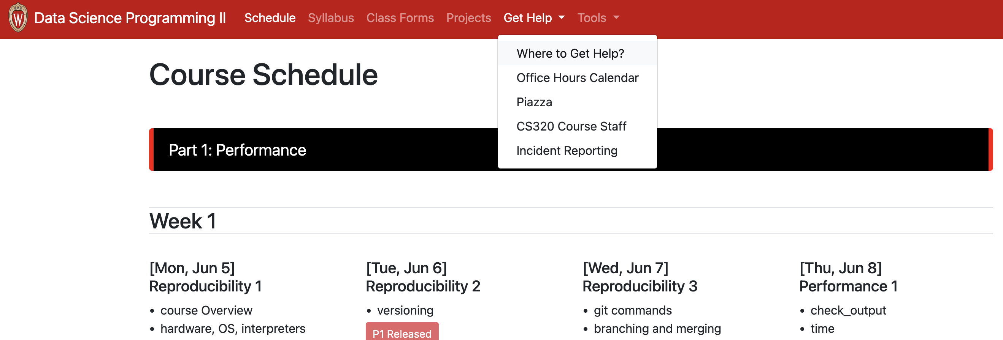
Course Website
https://tyler.caraza-harter.com/yiyin/su23/schedule.html
read syllabus and
where to get help
pages carefully
I'll also use Canvas for:
Announcements
Quizzes/exams
Zoom: lectures, labs, office hours
Late day summaries
Grades

Slide 8
Class Organization: People
Groups
you'll be assigned to a group of 4-7 students
groups will last the whole semester
collaboration with group members are allowed (not required) on labs, quizzes, and group part of the projects
collaboration with non-group members is not allowed

Slide 9
Communication
Drop-in Office Hours:
Course website – Get Help – Office Hour Calendar
Queue: https://ohwl.herokuapp.com/
Piazza
Don't post >5 lines of project-related code (considered cheating)
Private posts disabled
Forms
https://tyler.caraza-harter.com/yiyin/su23/surveys.html
Student Information Survey, Exam Conflicts Forms, Project/Lab Grading Issue Form, Feedback Form, Thank You Form
Email (least preferred)
me: yshen82@wisc.edu
TA: Victor vsuciu@wisc.edu
Course staff: https://canvas.wisc.edu/courses/355770/pages/course-staff

Slide 10
Scheduled Activities
Lectures (MTWR 10:00 – 10:50 AM) (2% overall)
Recommendation: use your laptop to take notes on the provided template notebook and another screen to follow along the lecture
Attendance is required. Attendance recorded through Google forms
14 drops out of 38 lectures
Labs (TR 11:00 – 11:50 AM) (4% overall)
Work through lab activities with group mates
320 staff will circulate around breakout rooms to answer questions
Attendance is required. 6 drops out of 18 labs
5 attendance points per lab:
2 for arriving no later than 5 mins after the lab starts
3 for showing sufficient working progress (submit code and/or running results to Canvas at the end of the lab)

Slide 11
Graded Work: Quizzes & Exams
Eight Online Quizzes - 1% each (1 drop, 7% overall)
cumulative, no time limit
on Canvas, open book/notes
can take together AT THE SAME TIME with group members (no help from other human is allowed)
Midterms - 11% each (22% overall)
cumulative, individual, multi-choice, 50 minutes
one-page two-sided note sheet
Friday, June 30th, 7:00PM - 8:30PM
Friday, July 21st, 7:00PM - 8:30PM
Final - 15%
cumulative, individual, multi-choice, 2 hours
two-page two-sided note sheet
Thursday, August 10th, 10:00AM - 12:30PM

Slide 12
Graded Work: Projects & Surveys
7 Projects - 7% each (49% overall)
format: python notebook or module
group part: you can optionally collaborate with group
individual part: must be done individually (only receive help from 320 staff)
regular deadlines on course website
late days: overall 8 late days
hard deadline: 4 days after the regular deadline – maximum 2 late days; 10% score penalty per day after day 2
tester.py with TA evaluation
clearing auto-grader on the submission portal (course website) is mandatory
Surveys (1% overall)

Slide 13
Letter Grades
Your final grade is based on sum of all points earned
Your grade does not depend on other students' grade
Scores will NOT be rounded up at the end of the semester
No major score changes at the end of the semester
No extra credits
93% - 100%: A
88% - 92.99%: AB
80% - 87.99%: B
75% - 79.99%: BC
70% - 74.99%: C
60% - 69.99%: D
Grade cut-offs

Slide 14
Time Commitment & Academic Conduct
Project commitment
10-12 hours per project is typical (2-4 hours can be done in labs)
20% of students sometimes spend 20+ hours on some projects
recommendation: start early and be proactive
Typical Weekly Expectations
6 hours - lecture/lab
8 hours - project coding
2 hours - reading/quizzes/etc
Please talk to me if you're feeling overwhelmed with 320 or your semester in general.
Academic Conduct
Read syllabus to make sure you know what is and isn’t acceptable.
We will run plagiarism detector on project submissions.

Slide 15
Reading: same as 220/301 and some others...
I'll post links to other online articles and notes
Lectures don't assume any reading prior to class

Slide 16
Tips for 320 Success
Just show up
Get 100% on attendance, don't miss quizzes, submit group work
Use office hours
Do labs before projects
Take the lead on group collaboration
Learn debugging
Run the tester often
If you're struggling, reach out -- the sooner, the better

Slide 17
Today's Lecture:
Reproducibility

Slide 18
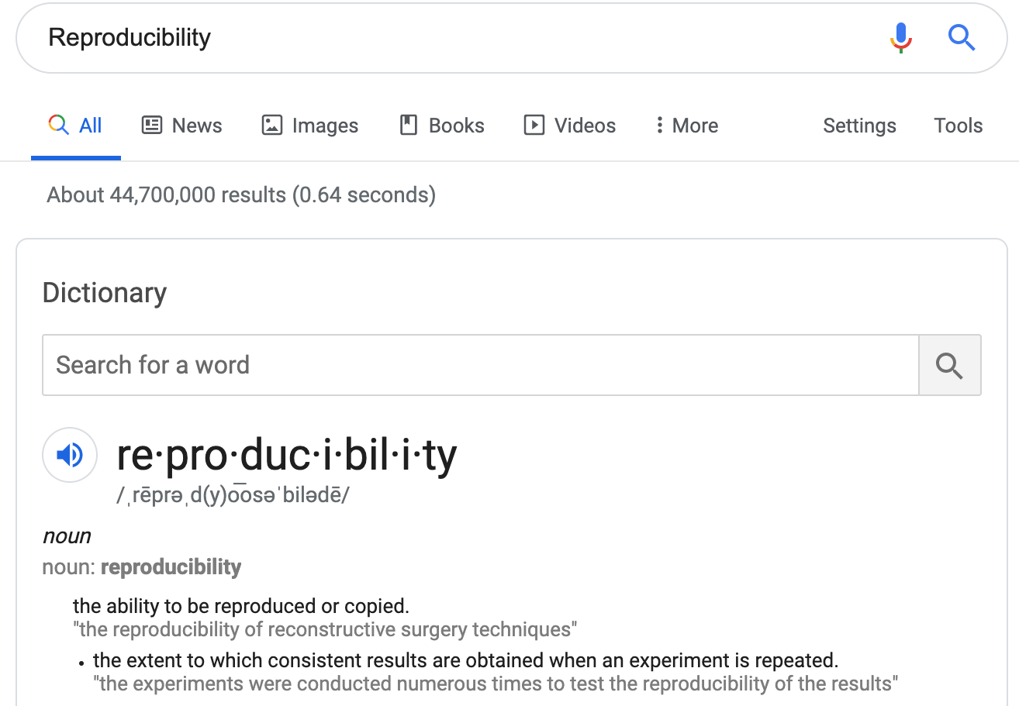
Discuss: how might we define "reproducibility" for a data scientist?

Slide 19
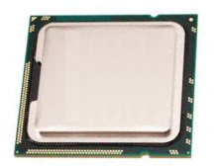
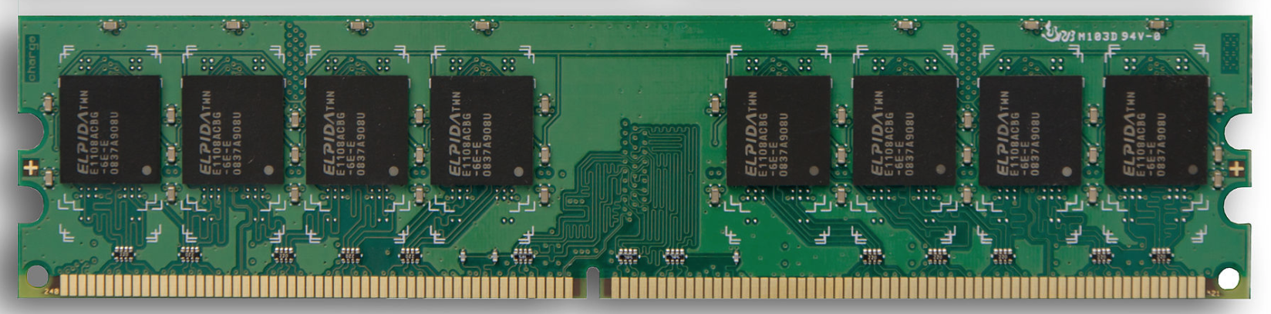
Big question: will my program run on someone else's computer? (not necessarily written in Python)
Things to match:
CPU
1
Hardware
2
Operating System
next lecture
3
Dependencies
next lecture

Slide 20
Hardware: Mental Model of Process Memory
Imagine...
one huge list, per each running program process, called "address space"
every entry in the list is an integer between 0 and 255 (aka a "byte")
values (bytes)
0
0
0
0
0
0
0
0
0
0
0
0
0
0
0
0
...
0
1
2
3
4
5
6
7
8
9
10
11
12
13
14
15
indexes (aka "addresses")

Slide 21
How can we use one giant list to handle the following?
multiple lists
variables and other references
strings
code
data
0
0
0
0
0
0
0
0
0
0
0
0
0
0
0
0
...
0
1
2
3
4
5
6
7
8
9
10
11
12
13
14
15
Is this really all we have for state?

Slide 22
How can we use one giant list to handle the following?
multiple lists
variables and other references
strings
code
0
0
0
0
0
0
0
0
3
20
0
0
11
22
33
0
...
0
1
2
3
4
5
6
7
8
9
10
11
12
13
14
15
the [3,20] list starts at index address 8 in the giant list
the [11,22,33] list starts at address 12 in the giant list

Slide 23
How can we use one giant list to handle the following?
multiple lists
variables and other references
strings
code
0
0
0
0
0
0
0
0
3
20
0
0
11
22
33
0
...
0
1
2
3
4
5
6
7
8
9
10
11
12
13
14
15
# fast
L2.append(44)
implications for performance...

Slide 24
How can we use one giant list to handle the following?
multiple lists
variables and other references
strings
code
0
0
0
0
0
0
0
0
3
20
0
0
11
22
33
44
...
0
1
2
3
4
5
6
7
8
9
10
11
12
13
14
15
# fast
L2.append(44)
implications for performance...

Slide 25
How can we use one giant list to handle the following?
multiple lists
variables and other references
strings
code
0
0
0
0
0
0
0
0
3
20
0
0
11
22
33
44
...
0
1
2
3
4
5
6
7
8
9
10
11
12
13
14
15
# fast
L2.append(44)
# slow
L2.pop(0)
implications for performance...

Slide 26
How can we use one giant list to handle the following?
multiple lists
variables and other references
strings
code
0
0
0
0
0
0
0
0
3
20
0
0
22
33
44
...
0
1
2
3
4
5
6
7
8
9
10
11
12
13
14
15
# fast
L2.append(44)
# slow
L2.pop(0)
implications for performance...

Slide 27
How can we use one giant list to handle the following?
multiple lists
variables and other references
strings
code
0
0
0
0
0
0
0
0
3
20
0
0
22
33
44
0
...
0
1
2
3
4
5
6
7
8
9
10
11
12
13
14
15
# fast
L2.append(44)
# slow
L2.pop(0)
We'll think more rigorously about
performance in CS 320 (big-O notation)

Slide 28
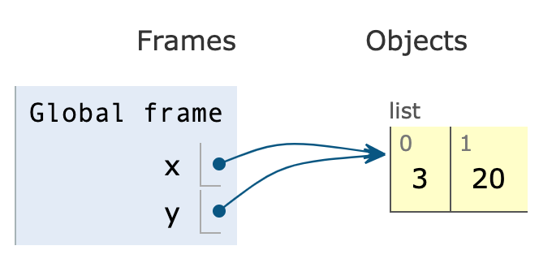
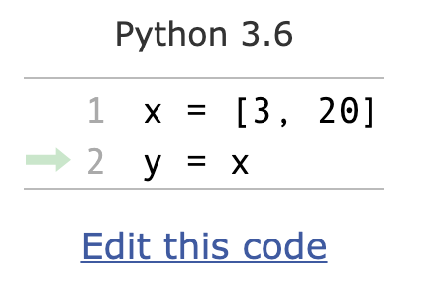
How can we use one giant list to handle the following?
multiple lists
variables and other references
strings
code
the x variable is at address 3
the y variable is at address 5
0
0
0
8
0
8
0
0
3
20
0
0
0
0
0
0
...
0
1
2
3
4
5
6
7
8
9
10
11
12
13
14
15
PythonTutor's visualization

Slide 29
How can we use one giant list to handle the following?
multiple lists
variables and other references
strings
code
discuss: how?
0
0
0
0
0
0
0
0
0
0
0
0
0
0
0
0
...
0
1
2
3
4
5
6
7
8
9
10
11
12
13
14
15
Is this really all we have for state?

Slide 30
How can we use one giant list to handle the following?
multiple lists
variables and other references
strings
code
???
0
0
0
0
0
0
0
0
0
0
0
0
0
67
65
66
...
0
1
2
3
4
5
6
7
8
9
10
11
12
13
14
15
code
65
66
67
68
...
letter
A
B
C
D
...
encoding:
f = open("file.txt", encoding="utf-8")

Slide 31
How can we use one giant list to handle the following?
multiple lists
variables and other references
strings
code
"CAB"
0
0
0
0
0
0
0
0
0
0
0
0
0
67
65
66
...
0
1
2
3
4
5
6
7
8
9
10
11
12
13
14
15
code
65
66
67
68
...
letter
A
B
C
D
...
encoding:
f = open("file.txt", encoding="utf-8")

Slide 32
How can we use one giant list to handle the following?
multiple lists
variables and other references
strings
code
i = 0
while ????:
i += 2
# what line next?
operands
operator
0
0
0
0
0
0
0
0
...
...
5
4
2
33
10
0
...
0
1
2
3
4
5
6
7
8
9
10
11
12
13
14
15
code
5
8
33
...
operation
ADD
SUB
JUMP
...
Instruction Set
Notes:
f22: section 1

Slide 33
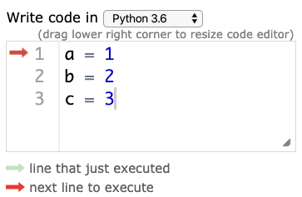
Hardware: Mental Model of CPU
CPUs interact with memory:
keep track of what instruction we're on
understand instruction codes
much more
CPU
0
0
0
0
0
0
0
0
...
...
5
4
2
33
10
0
...
0
1
2
3
4
5
6
7
8
9
10
11
12
13
14
15
code
5
8
33
...
operation
ADD
SUB
JUMP
...
Instruction Set

Slide 34
Hardware: Mental Model of CPU
CPUs interact with memory:
keep track of what instruction we're on
understand instruction codes
much more
CPU
add 2 to variable
0
0
0
0
2
0
0
0
...
...
5
4
2
33
10
0
...
0
1
2
3
4
5
6
7
8
9
10
11
12
13
14
15
code
5
8
33
...
operation
ADD
SUB
JUMP
...
Instruction Set

Slide 35
Hardware: Mental Model of CPU
CPUs interact with memory:
keep track of what instruction we're on
understand instruction codes
much more
CPU
go back to top of loop
0
0
0
0
2
0
0
0
...
...
5
4
2
33
10
0
...
0
1
2
3
4
5
6
7
8
9
10
11
12
13
14
15
code
5
8
33
...
operation
ADD
SUB
JUMP
...
Instruction Set

Slide 36
Hardware: Mental Model of CPU
CPUs interact with memory:
keep track of what instruction we're on
understand instruction codes
much more
CPU
0
0
0
0
2
0
0
0
...
...
5
4
2
33
10
0
...
0
1
2
3
4
5
6
7
8
9
10
11
12
13
14
15
code
5
8
33
...
operation
ADD
SUB
JUMP
...
Instruction Set

Slide 37
Hardware: Mental Model of CPU
discuss: what would happen if a CPU tried to execute an instruction for a different CPU?
0
0
0
0
0
0
0
0
...
...
5
4
2
33
10
0
...
0
1
2
3
4
5
6
7
8
9
10
11
12
13
14
15
code
5
8
33
...
operation
ADD
SUB
JUMP
...
code
5
8
33
...
operation
SUB
ADD
undefined
...
Instruction Set
for CPU X
Instruction Set
for CPU Y
Notes:
s22: lec 1+2 ended here

Slide 38
Hardware: Mental Model of CPU
a CPU can only run programs that use instructions it understands!
CPU Y
0
0
0
0
0
0
0
0
...
...
5
4
2
33
10
0
...
0
1
2
3
4
5
6
7
8
9
10
11
12
13
14
15
code
5
8
33
...
operation
ADD
SUB
JUMP
...
code
5
8
33
...
operation
SUB
ADD
undefined
...
Instruction Set
for CPU X
Instruction Set
for CPU Y

Slide 39
A Program and CPU need to "fit"
Program A
Program B
CPU X
CPU Y
Program B
Program A
CPU X
CPU Y

Slide 40
A Program and CPU need to "fit"
Program A
Program B
CPU X
CPU Y
why haven't we noticed this yet for our Python programs?

Slide 41
Interpreters
program.py
same
program.py
python code
python.exe (X)
python.exe (Y)
different
machine code
CPU X
CPU Y
different
Interpreters (such as python.exe) make it easier to run the same code on different machines
A compiler is another tool for running the same code on different CPUs

Slide 42
Interpreters
program.py
same
program.py
python code
python.exe (X)
different
python.exe (Y)
machine code
CPU X
different
CPU Y
Interpreters (such as python.exe) make it easier to run the same code on different machines
Discuss: if all CPUs had the instruction set,
would we still need a Python interpreter?

Slide 43
Big question: will my program run on someone else's computer? (not necessarily written in Python)
Things to match:
1
many others...
Hardware
2
Operating System
3
Dependencies
[this semester]

Slide 44
OS jobs: Allocate and Abstract Resources
[like CPU, hard drive, etc]
1
2
Allocation
Abstraction
Process B
f = open("file.txt")
data = f.read()
f.close()
waiting
...
Process Z
convenient
OS decides
Operating System
running
Process A
inconvenient
CPU X
only one process can run on CPU at a time (or a few things if the CPU has multiple "cores")
ignorant of
files/directories

Slide 45
Harder to reproduce on different OS...
bad.py
Python Interpreter
f = open("/data/file.txt")
...
Windows
CPU X
The Python interpreter mostly lets you
[Python Programmer] ignore the CPU you run on.
But you still need to work a bit to "fit" the code to the OS.

Slide 46
Harder to reproduce on different OS...
good.py
Python Interpreter
f = open("c:\data\file.txt")
...
Windows
CPU X
The Python interpreter mostly lets you
[Python Programmer] ignore the CPU you run on.
But you still need to work a bit to "fit" the code to the OS.

Slide 47
Harder to reproduce on different OS...
good.py
# solution 1:
f = open(os.path.join("data", "file.txt"))
...
Python Interpreter
Windows
# solution 2:
tell anybody reproducing your results to use the same OS!
CPU X
tradeoffs?
The Python interpreter mostly lets you
[Python Programmer] ignore the CPU you run on.
But you still need to work a bit to "fit" the code to the OS.

Slide 48

VMs (Virtual Machines)
popular virtual
machine software
Mac OS X
Programs
programs
programs
Linux OS
Windows OS
Virtual Machine
Virtual Machine
programs
Mac Operating System
Physical Machine
[CPU, memory, etc]
With the right virtual machines created and operating systems installed, you could run programs for Mac, Linux, and Windows -- at the same time without rebooting!

Slide 49

The Cloud
popular cloud providers
cloud providers let you rent VMs in the cloud on hourly basis (e.g., $15 / month)
Linux
here
VM
VM
VM
VM
remote connection
ssh session>
Windows, Mac, whatever
we'll use GCP virtual machines this semester
[setup in lab]
run in PowerShell/bash to access CS lab
ssh user@best-linux.cs.wisc.edu
https://docs.microsoft.com/en-us/windows-server/administration/openssh/openssh_install_firstuse

Slide 50
Lecture Recap: Reproducibility
Big question: will my program run on someone else's computer?
Things to match:
1
a program must fit the CPU;
python.exe will do this, so
program.py won't have to
Hardware
2
we'll use Ubuntu Linux on
virtual machines in the cloud
Operating System
3
Dependencies
next time: versioning

Slide 51
Recap of 15 new terms
reproducibility: others can run our analysis code and get same results
process: a running program
byte: integer between 0 and 255
address space: a big "list" of bytes, per process, for all state
address: index in the big list
encoding: pairing of letters characters with numeric codes
CPU: chip that executes instructions, tracks position in code
instruction set: pairing of CPU instructions/ops with numeric codes
operating system: software that allocates+abstracts resources
resource: time on CPU, space in memory, space on SSD, etc
allocation: the giving of a resource to a process
abstraction: hiding inconvenient details with something easier to use
virtual machine: "fake" machine running on real physical machine virtual machine: allows us to run additional operating systems
cloud: place where you can rent virtual machines and other services
ssh: secure shell -- tool that lets you remotely access another machine

